Slide 1
Assignment 8: Bank Holding Companies (BHC)
Glenn, Michael, Eric, Kramer, Nikitia

Slide 2

J.P. Morgan Chase & Co. (JPMC) is a global BHC comprised of four specialized business units:
Consumer & Community Banking (CCB)
Commercial Banking (CB)
Segment: Large business services.
Services: Lending, investment, and financial solutions.
Asset & Wealth Management (AWM)
Segment: High-net-worth individuals and institutional investors.
Services: Investment and wealth management services.
Segment: Individual consumers and small businesses.
Services: Personal banking, lending, and investment.
Corporate & Investment Bank (CIB)
Segment: Investment banking, market-making, and treasury services.
Services: High-end corporate and institutional clients.

Slide 3
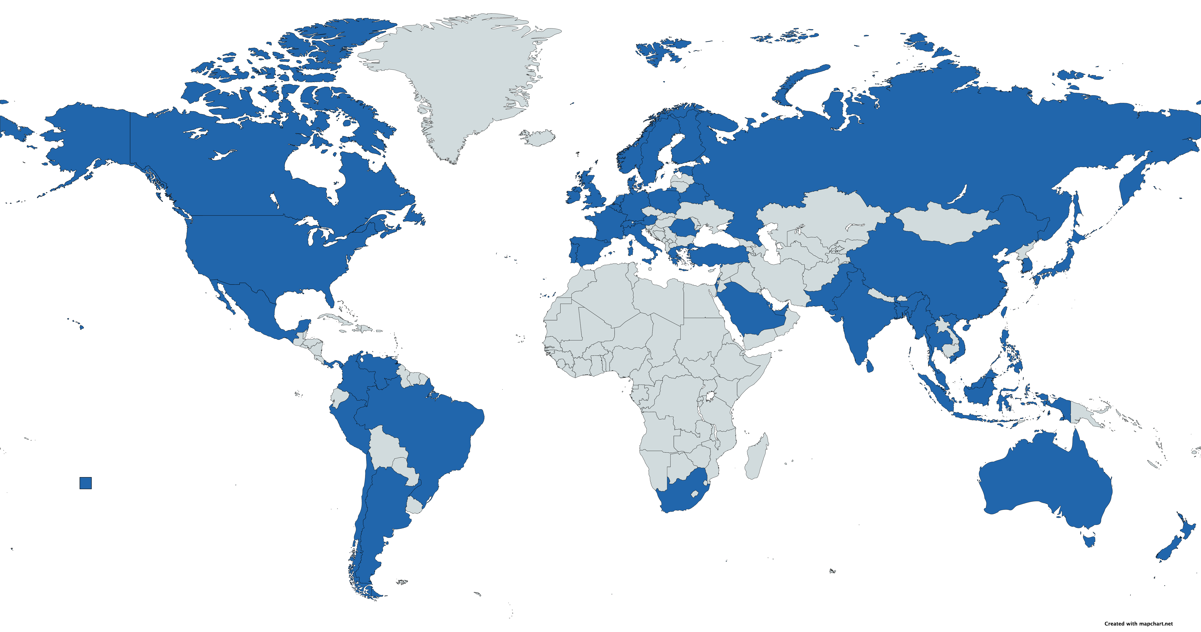
JP Morgan Chase & Co. Global Presence

Slide 4
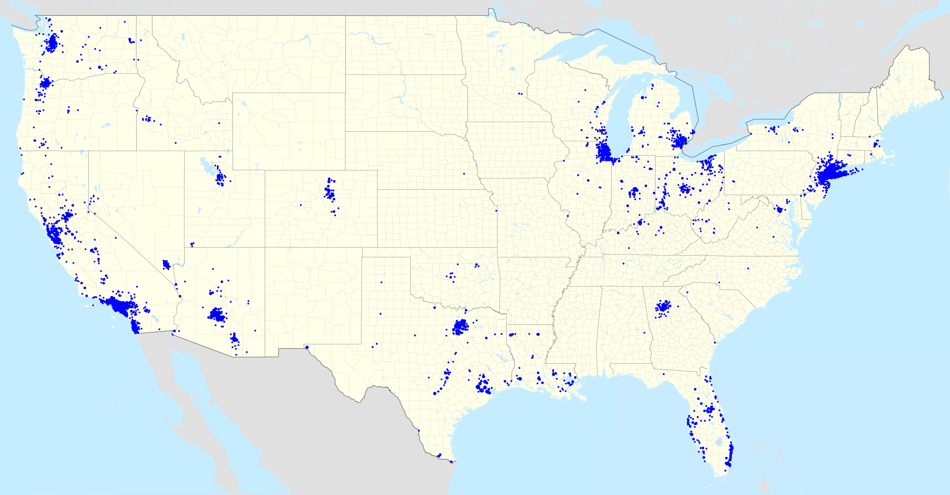
JP Morgan Chase & Co. National Presence

Slide 5
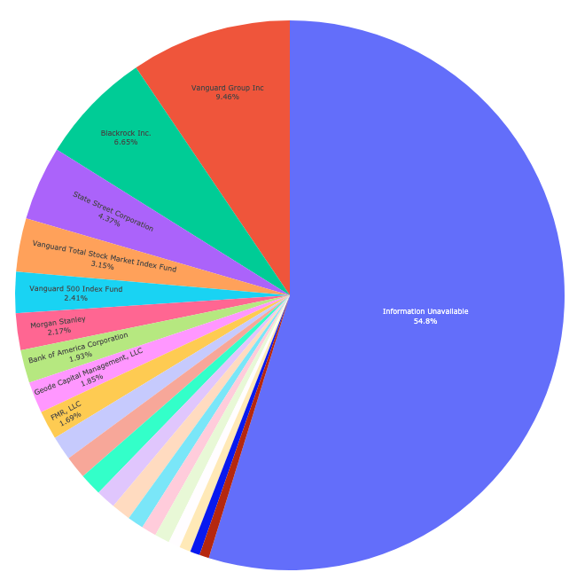
Breakdown of Ownership

Slide 6

Insider Trading
For the first time in his history as CEO, Jamie Dimon sold 12% of his holdings in JPMC
Caused a 3% drop in JPMC value due to the sell-off
Bank representatives caution this is not related to the bank’s performance

Slide 7
Markets View on JPMC
Wait for nikita

Slide 8
Bank Call Reports
Wait for nikita

Slide 9
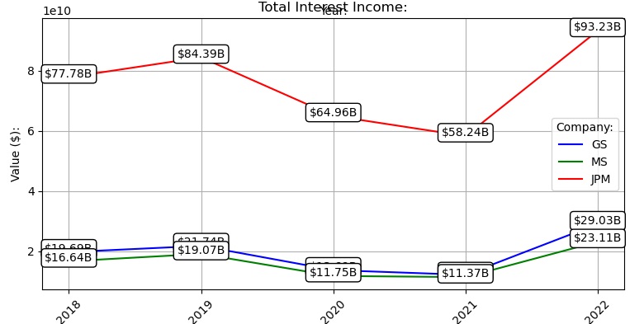
JPMC: Total Interest Income

Slide 10
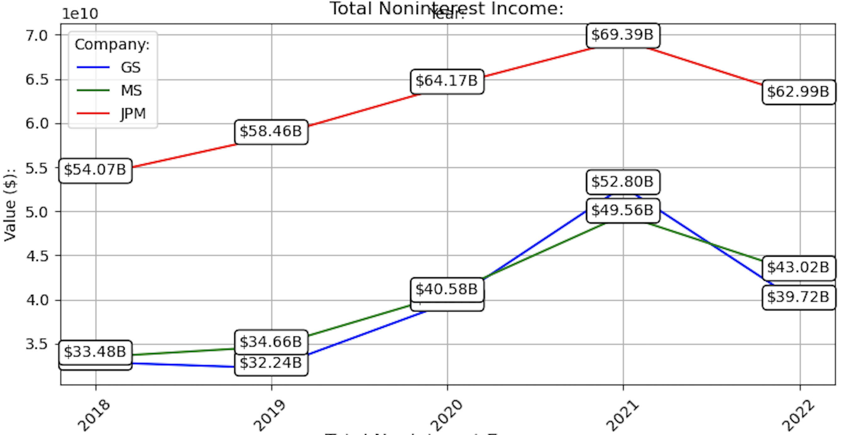
JPMC: Total Non-Interest Income

Slide 11
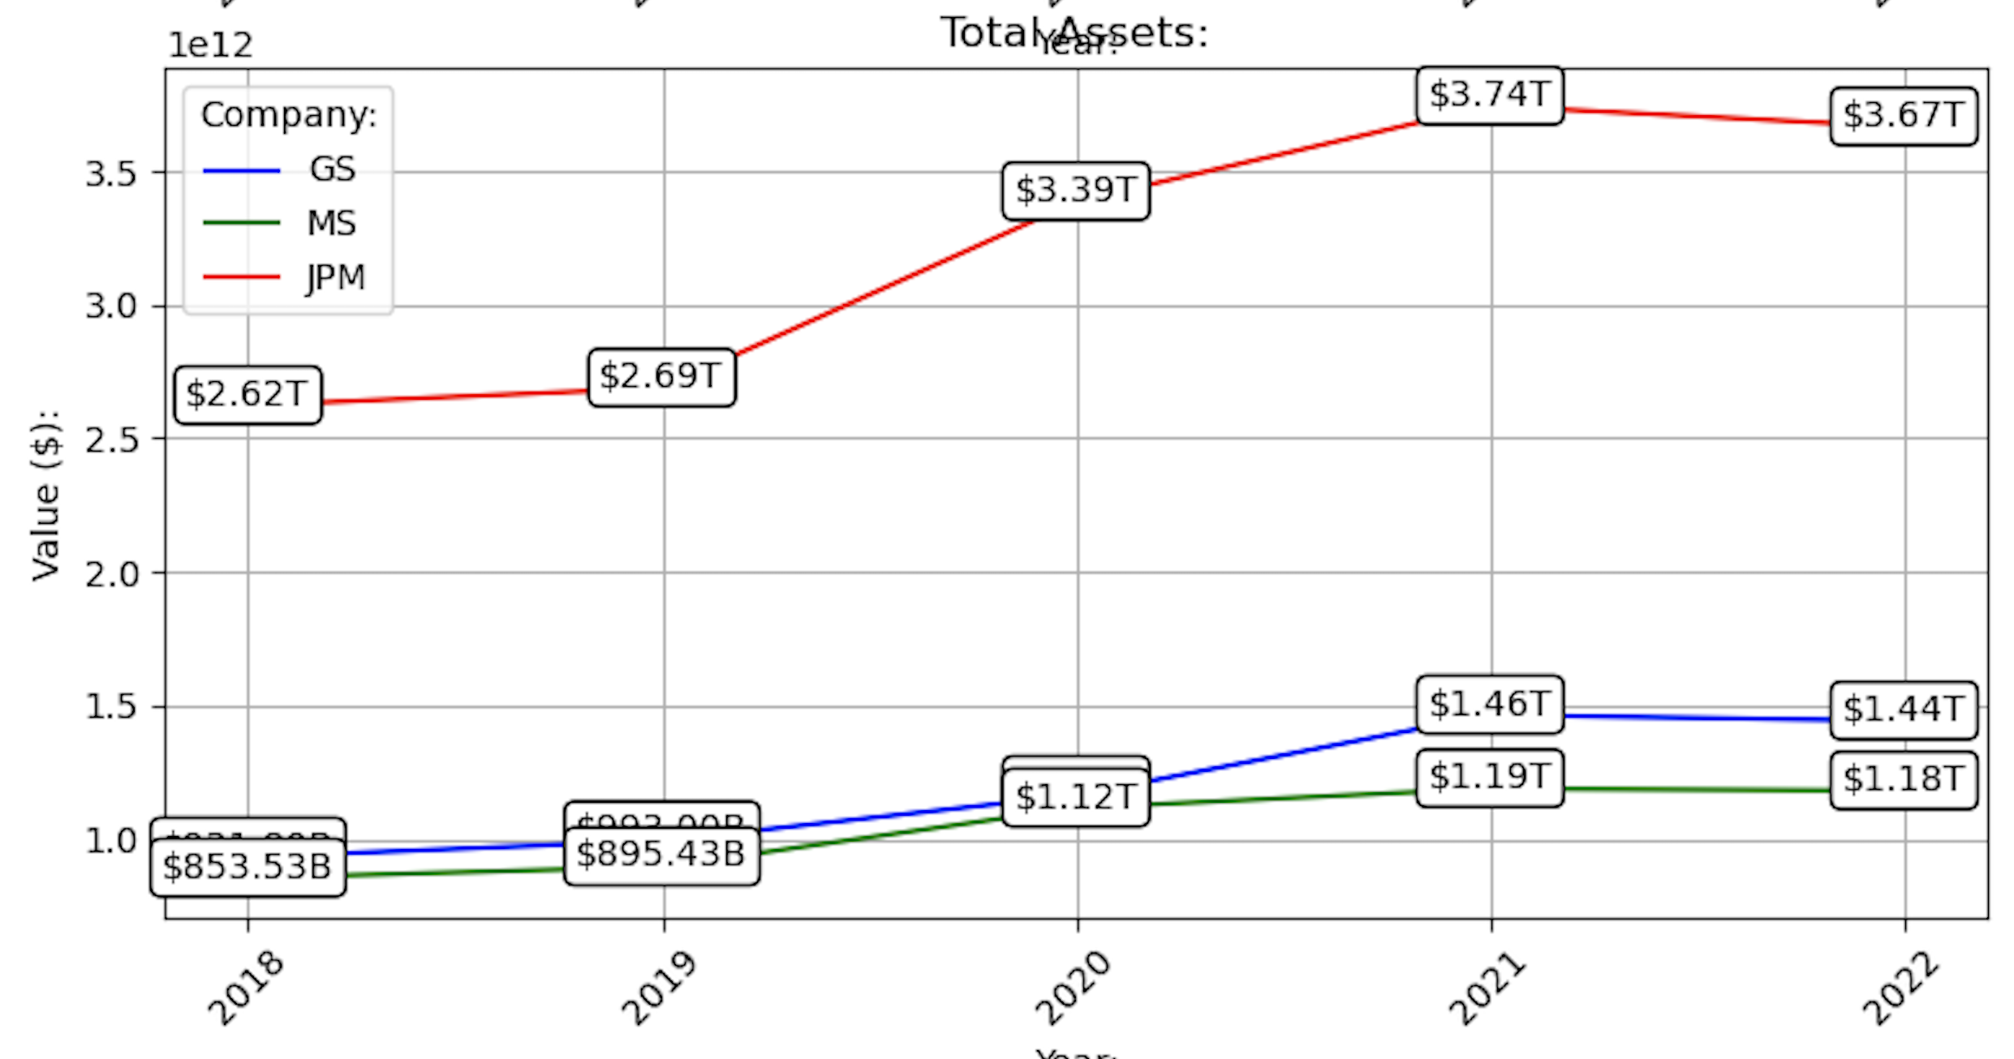
JPMC: Total Assets

Slide 12
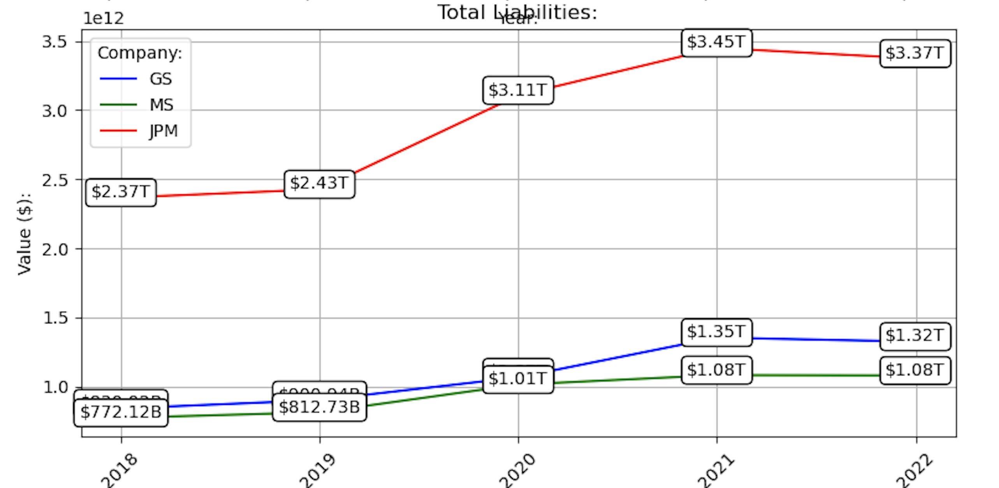
JPMC: Total Liabilities

Slide 13
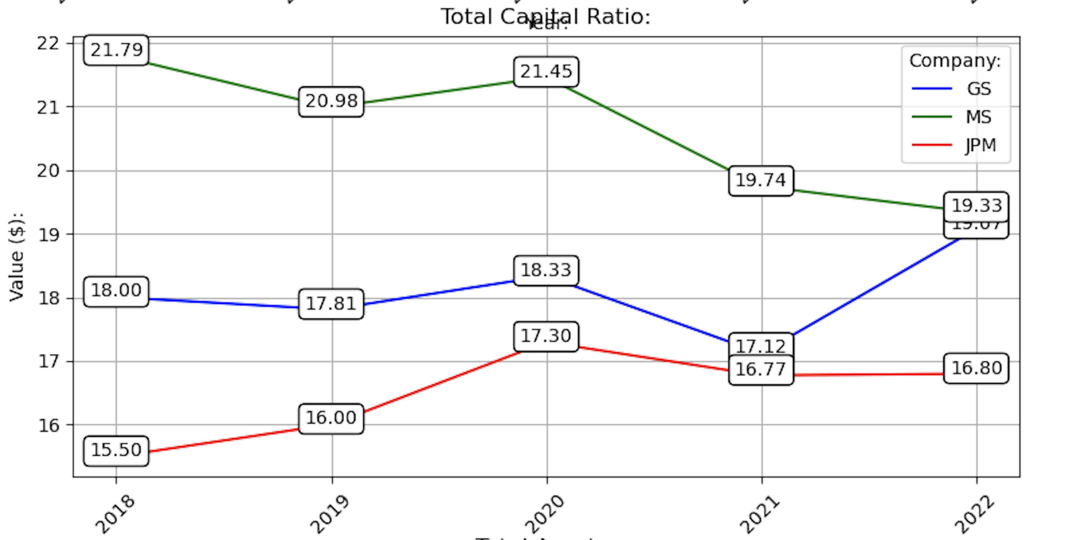
JPMC: Total Capital Ratio

Slide 14
Asset Liability Management (ALM) & Risk Profile

Slide 15
Asset and Liability Committee (ALCO)
ALCO oversees the ALM of JPMC using the following framework:
Investment in High-Quality Securities:
Focus of the Treasury and CIO on long-term investments in high-quality securities.
Part of the firm’s investment securities portfolio.
Use of Derivatives:
Treasury and CIO utilize derivatives for ALM objectives.
Key tool for risk management.
Cash Position Management:
Managed through deposits at central banks and short-term instruments.
Ensures liquidity and appropriate funding risk management.

Slide 16
Chief Investment Office, Treasury, and Corporate (CTC) Risk Committee
CTC Risk Committee's Role:
Manages JPMC’s risk policy regarding structural interest rate.
Policy subject to approval by the Board Risk Committee.
Risk Transfer and Management:
Business units transfer interest rate risk to the Chief Investment Office via Funds Transfer Pricing (FTP).
Earnings-At-Risk Models:
Used for stress testing beyond VaR modeling.
Includes balance sheet forecasting, determining deposit betas, and assessing risks under various monetary policies.
Sensitivity to ±100 basis point shifts in interest rates.
Short-term shifts impact liabilities, while long-term shifts affect asset repricing.
Key scenarios: Parallel shifts, steeper/flatter yield curve changes.

Slide 17
Liquidity Risk Management (LRM)
Dedicated Liquidity Risk Management:
Interfaces with firm- and LOB-level ALCOs and Risk Committees.
Regular stress testing including standardized and current scenarios.
Corporate Structure and Funding:
Parent company JPMC Holdings LLC supports subsidiary operations.
Contingency Funding and Compliance:
Establishes Contingency Funding Plan aligned with LCR.
Maintains 30 days' cash outflow provision in High-Quality Liquid Assets Ensures no overreporting of non-transferable HQLA assets.
Compliant with 100% minimum NSFR requirement.
Does not primarily rely on Federal Reserve discount window for liquidity.

Slide 18
Basel III Compliance and Capital Ratios
Basel III Compliance:
Maintains risk-based ratios above Basel III advanced requirements.
CET1 Capital Ratio:
As of December 31, 2022, CET1 capital ratio was 13.2%.
Exceeds Basel III requirement of 4.5% (7%*).
Adoption of SA-CCR:
Started January 1, 2022, for Counterparty Credit Risk.
Higher Exposure at Default (EAD) and increases Risk-Weighted Assets.
JPMC's risk profile was affected by only 30 basis points.

Slide 19
ALM Models and Assumptions
Regulatory Compliance in ALM:
Models align with regulatory standards, focusing on RWA and LCR.
Strict adherence to standards, usually exceeding required thresholds.
Liquidity Coverage Ratio (LCR):
The banking segment's LCR averages over 125%.
Indicates a conservative, stability-focused approach rather than aggressive growth.

Slide 20
Funding Stability and Deposit Trends
Funding Stability:
Predominantly sourced from consumer and wholesale operating deposits.
Modeling Preferences and Trends:
Prefers using average deposit balances over period-end figures.
Recent 10-Q (Nov 1, 2023) shows a decrease in deposits.
Impact of High-Interest Environment:
Commercial banking and asset & wealth management segments experienced attrition.
Shifts to higher yielding assets and high consumer demand led to deposit decreases.

Slide 21
Credit Loss Allowance
Increase in Credit Loss Allowance:
Grew from $18.7 billion (Dec 31, 2021) to $24.3 billion (Sep 30, 2023).
Breakdown of Recent Increases:
$707 million increase in consumer credit losses, particularly in credit cards.
$623 million rise in wholesale credit losses.
Driving Factors:
Attributed to deteriorating credit quality and a challenging macroeconomic outlook.

Slide 22
Risk Management Structure
Risk Classification and IRM:
Risks are categorized into strategic, credit/investment, market, and operational.
Features an Independent Risk Management (IRM) function.
Risk Governance:
Board risk committee and CEO-appointed Chief Risk Officer (CRO).
CRO oversees business line CROs and Chief Compliance Officer (CCO).
Three Lines of Defense Model:
First Line: Each Line of Business (LOB) manages its own risk.
Second Line: IRM function.
Third Line: Internal audit by General Auditor and Audit Committee.
Risk Appetite and Oversight:
Set by frameworks approved by CEO, CRO, and Board Risk Committee.
Incorporates JPM's "How We Do Business Principles."
Firmwide Valuation Governance Forum (VGF) manages valuation risk.

Slide 23
Appendix

Slide 24
Performance and Financial Position of the Bank
 |  | Net Income (Loss) | Net Interest Income | Total Noninterest Income | Total Interest Income | Total Noninterest Expense | Total Loans and Leases | Past Due and Nonaccrual Loans | Provision for Loan and Lease Losses | Total Liabilities and Equity Capital | Total Capital Ratio | Leverage Ratio | Total Assets | Total Liabilities
Company | Year
GS | 2018-01-01 | $10.46B | $3.78B | $32.91B | $19.69B | $23.48B | $127.63B | $311.00M | <NA> | $931.80B | 18.00 | 8.89 | $931.80B | $839.92B
 | 2019-01-01 | $8.47B | $4.37B | $32.24B | $21.74B | $24.97B | $146.55B | $214.00M | $990.00M | $993.00B | 17.81 | 8.73 | $993.00B | $900.94B
 | 2020-01-01 | $9.46B | $4.75B | $39.57B | $13.69B | $29.23B | $186.21B | $195.00M | $2.85B | $1.16T | 18.33 | 8.08 | $1.16T | $1.07T
 | 2021-01-01 | $21.64B | $6.47B | $52.80B | $12.12B | $31.94B | $247.29B | $790.00M | $358.00M | $1.46T | 17.12 | 7.30 | $1.46T | $1.35T
 | 2022-01-01 | $11.26B | $7.68B | $39.72B | $29.03B | $31.16B | $236.74B | $23.00M | $2.71B | $1.44T | 19.07 | 7.28 | $1.44T | $1.32T
JPM | 2018-01-01 | $32.47B | $55.40B | $54.07B | $77.78B | $63.45B | $1.01T | $3.71B | <NA> | $2.62T | 15.50 | 8.05 | $2.62T | $2.37T
 | 2019-01-01 | $36.43B | $57.59B | $58.46B | $84.39B | $66.22B | $993.49B | $3.37B | $5.45B | $2.69T | 16.00 | 7.85 | $2.69T | $2.43T
 | 2020-01-01 | $29.13B | $55.00B | $64.17B | $64.96B | $68.24B | $1.06T | $3.24B | $16.36B | $3.39T | 17.30 | 7.00 | $3.39T | $3.11T
 | 2021-01-01 | $48.33B | $52.54B | $69.39B | $58.24B | $71.78B | $1.14T | $3.06B | $-9.26B | $3.74T | 16.77 | 6.51 | $3.74T | $3.45T
 | 2022-01-01 | $37.68B | $67.13B | $62.99B | $93.23B | $75.70B | $1.18T | $2.38B | $6.39B | $3.67T | 16.80 | 6.63 | $3.67T | $3.37T
MS | 2018-01-01 | $8.75B | $6.55B | $33.48B | $16.64B | $28.82B | $150.64B | $130.00M | <NA> | $853.53B | 21.79 | 8.38 | $853.53B | $772.12B
 | 2019-01-01 | $9.04B | $6.67B | $34.66B | $19.07B | $30.10B | $172.66B | $137.00M | $120.00M | $895.43B | 20.98 | 8.26 | $895.43B | $812.73B
 | 2020-01-01 | $11.00B | $7.90B | $40.58B | $11.75B | $33.74B | $235.12B | $121.00M | $581.00M | $1.12T | 21.45 | 8.36 | $1.12T | $1.01T
 | 2021-01-01 | $15.03B | $10.00B | $49.56B | $11.37B | $40.03B | $269.65B | $176.00M | $82.00M | $1.19T | 19.74 | 7.12 | $1.19T | $1.08T
 | 2022-01-01 | $11.03B | $10.84B | $43.02B | $23.11B | $39.29B | $258.28B | $106.00M | $496.00M | $1.18T | 19.33 | 6.71 | $1.18T | $1.08T

